Slide 1
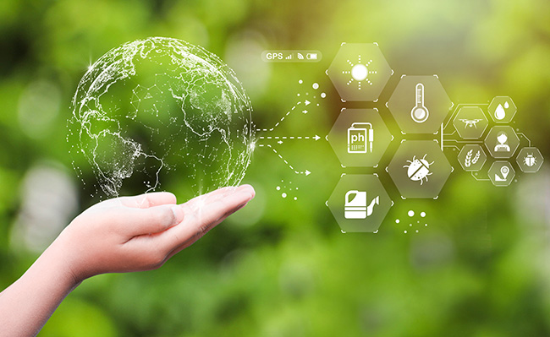
Innovative Idea For
Environmental Monitoring Using IOT

Slide 2
Agenda
Overview
Need of the Project
Block Diagram
Problem Faced
Future Scope

Slide 3
Overview
Use IOT sensors to monitor noise levels in the park. When noise exceeds acceptable levels, alerts can be sent to park staff to address issues and ensure a peaceful environment for visitors.

Slide 4
Need of the Project
Parks are designed to provide a peaceful and serene environment for visitors to connect with nature.
Excessive noise pollution disrupts this tranquility, affecting the park's primary purpose.
IOT-based noise monitoring helps maintain the park's natural ambiance and enhances the visitor experience.
Noise pollution can have adverse effects on human health, including stress, sleep disturbances, and increased risk of cardiovascular problems.
By monitoring noise levels, parks can protect the physical and mental well-being of their visitors.

Slide 5
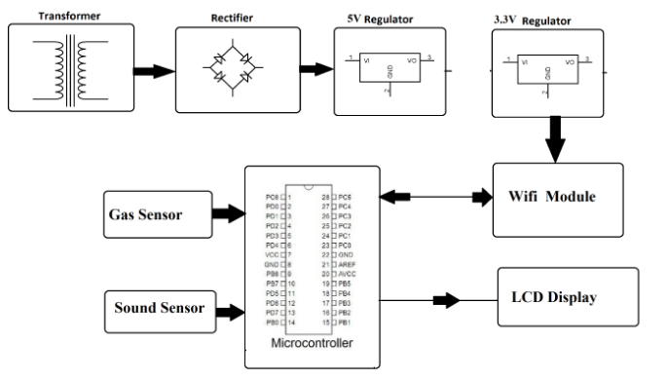
Block Diagram

Slide 6
Problem Faced
Ensuring that noise sensors provide accurate and calibrated data can be challenging. Sensors may drift or degrade over time, leading to Inaccurate readings.
Reliable data transmission can be difficult, especially in remote park areas with limited connectivity. Data may be lost or delayed, affecting real-time monitoring.
Ensuring a continuous power supply to IOT devices, especially in off-grid locations, can be a challenge.

Slide 7
Future Scope
Implement IOT-based systems that respond dynamically to noise levels. For instance, automated signs, lighting, or fountains that adjust based on noise levels to maintain a tranquil park atmosphere.
Implement IOT solutions that integrate with park activities, such as sports events or concerts, to automatically adjust noise levels and schedules to minimize disruption to other park goers.
The future of noise pollution monitoring in parks using IOT involves leveraging technology to enhance visitor experiences, protect natural ecosystems, and promote the overall well-being of park goers.
With continued advancements in IOT technology and a growing focus on environmental conservation, this field is likely to evolve and expand significantly in the coming years.

Slide 8
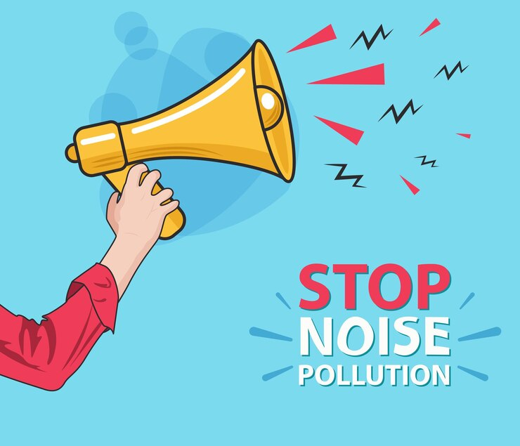
IN PARKS

